Slide 1
Knowledge Distillation

Slide 2
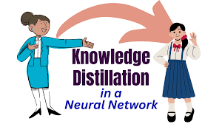
Agenda
Introduction
Key components
Methodology
Result(Accuracy graphs)
Challenges
Conclusion
References
Q&A

Slide 3
Introduction
What is Knowledge Distillation? A technique where a small model (student) learns from a large, powerful model (teacher). Goal: Achieve near-teacher performance in a lightweight student model. Why Use It? Faster inference for edge devices. Reduces computation and memory requirements.

Slide 4
Key components
Key Components
Teacher Model (Resnet 18):
Large, pre-trained, accurate.
Student Model (CNN 4):
Smaller, trained to mimic the teacher.
Distillation Loss:
Combines:
Cosine distance Loss: Cosine distance between last layer features of teacher's and student’s model.
True Labels Loss: Cross-entropy with ground truth

Slide 5
Methodology
Data Preparation – cifar100
Teacher model training – ResNet18
Extarct features from final layer
Student model design – cnn4
Knowledge Distillation – Cosine Distance
Evalution
Optimization - Temperature

Slide 6
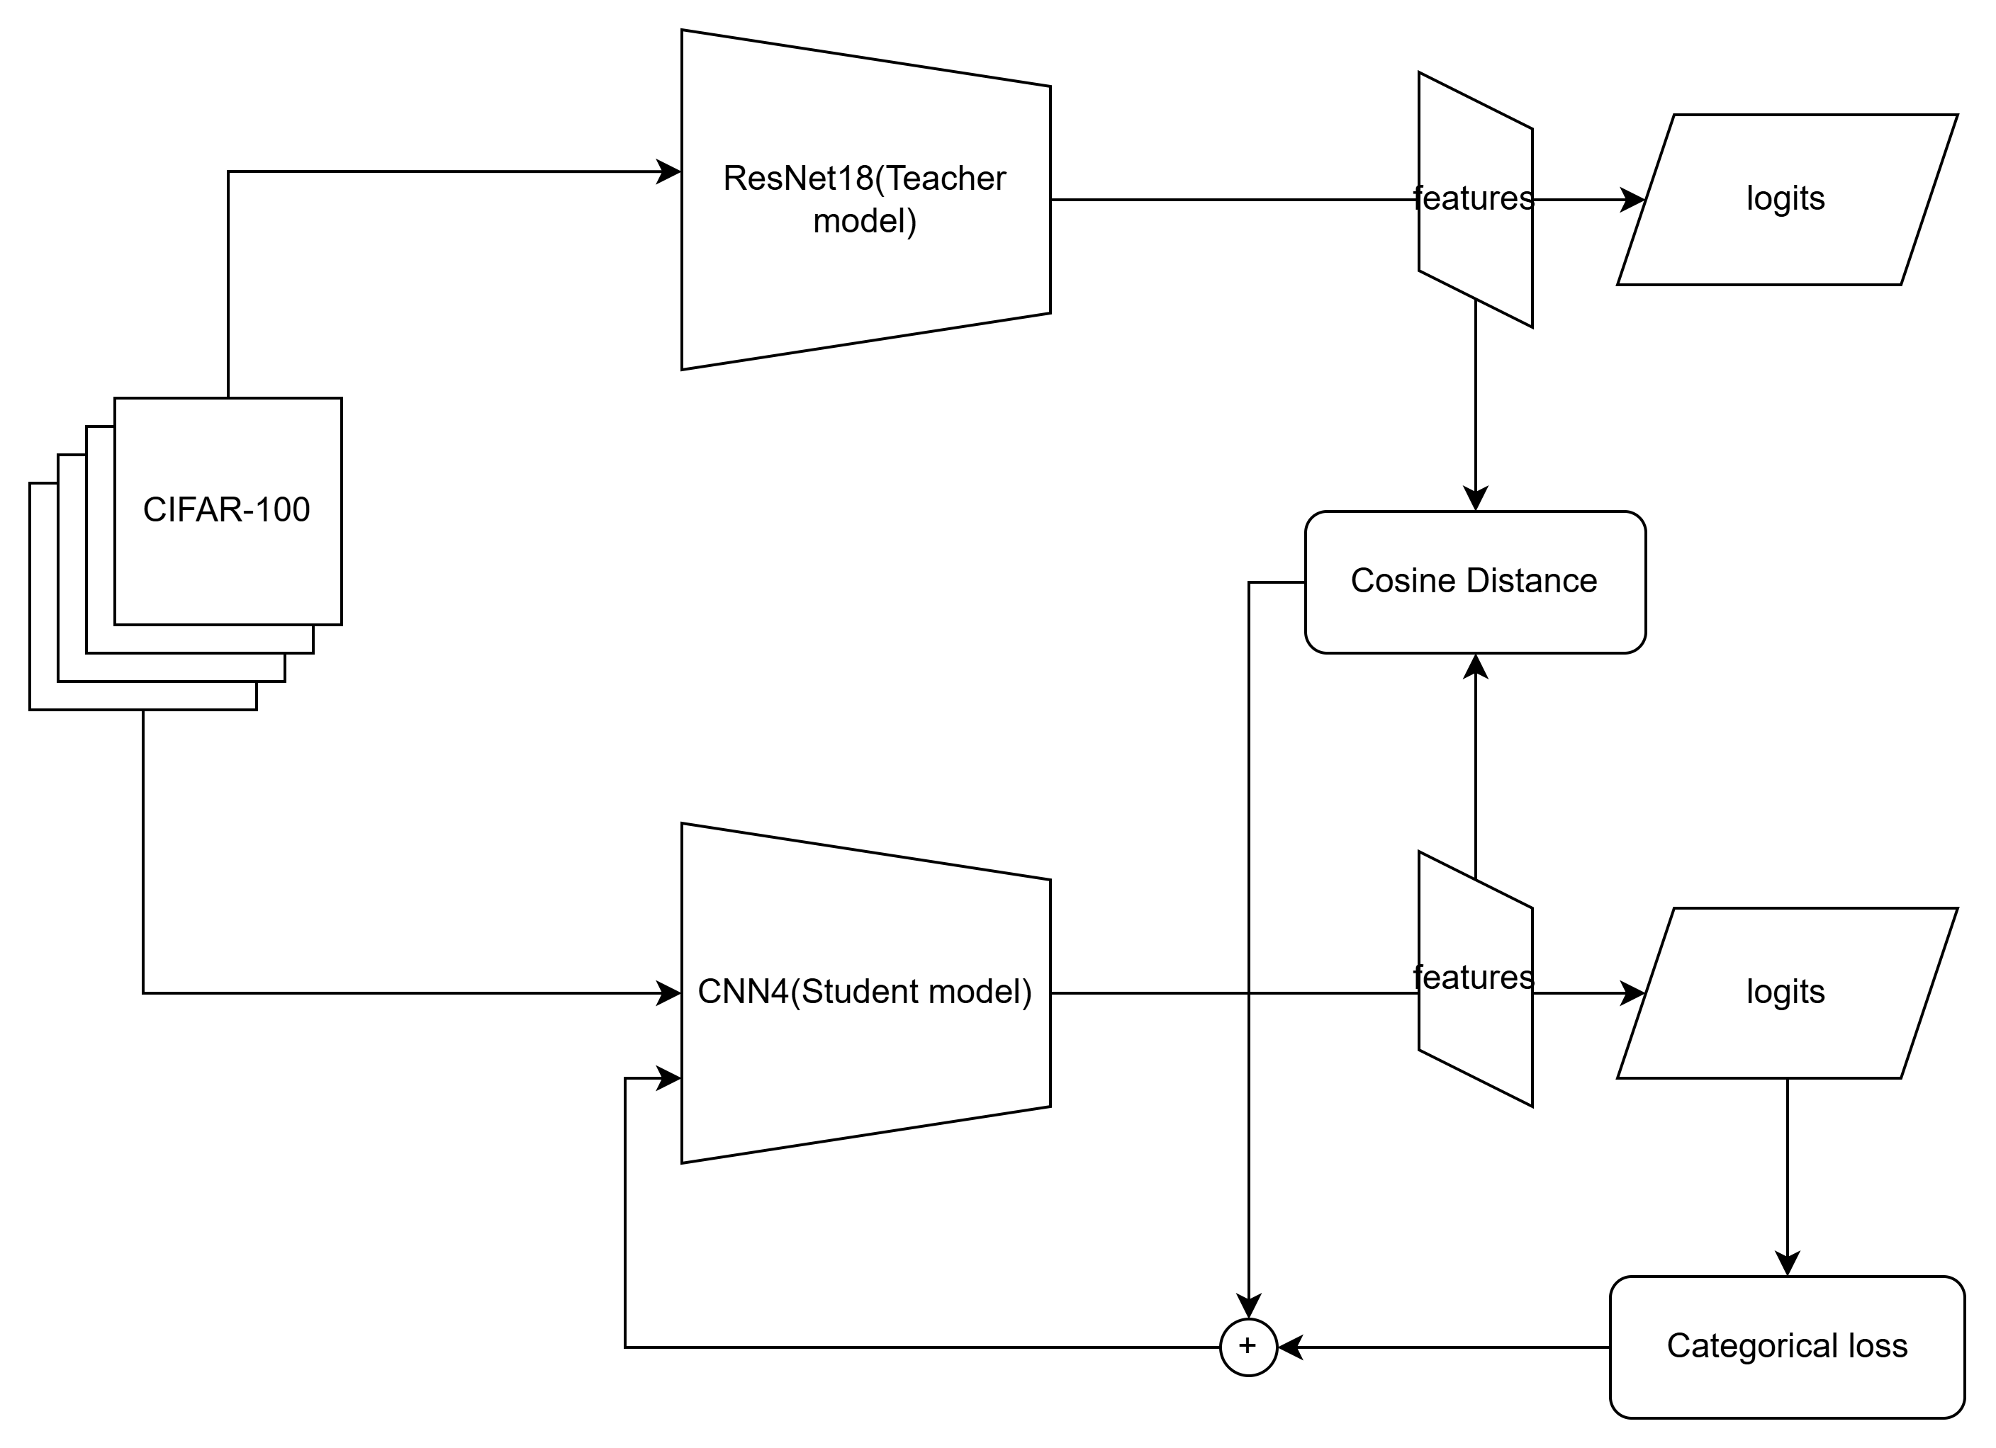
Architecture

Slide 7
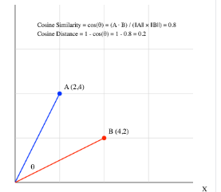


Loss Functions Formula:
Cosine Distance:
It is used to find the comparison between features of teacher model and student model
Categorical cross entropy:
It is used to find categorical loss from actual output and predicted output

Slide 8
Results (Accuracy)
Accuracy Comparison:
Under the guidance of teacher model(ResNet), student model(cnn4) accuracy has increased from 41% to 50% .
Model | Trainable Parameters(lakhs) | Validation Accuracy (%) | Train Accuracy (%)
Teacher | 100 | 61 | 80
Student | 1.2 | 41 | 48
Distilled model | 2 | 50 | 54

Slide 9
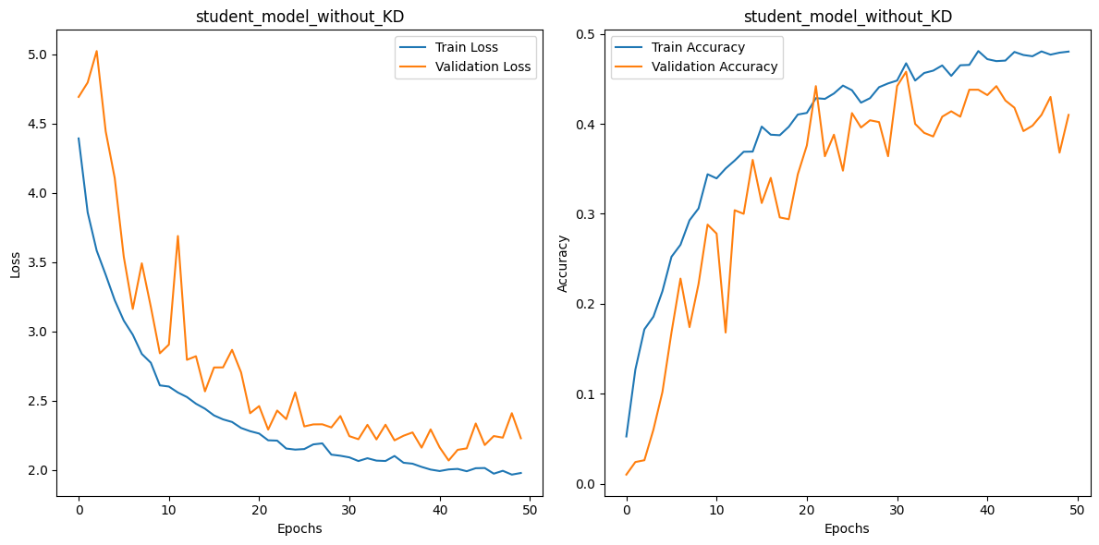
Graphs
Student model:

Slide 10
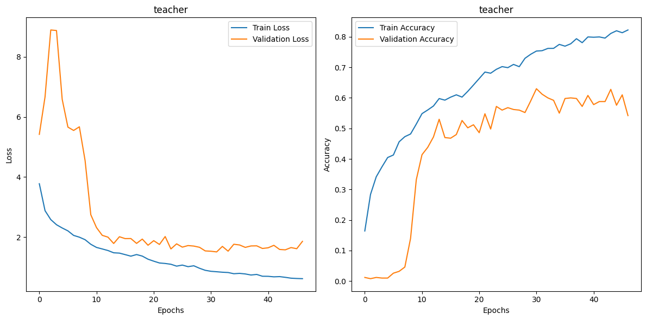
Teacher model:

Slide 11
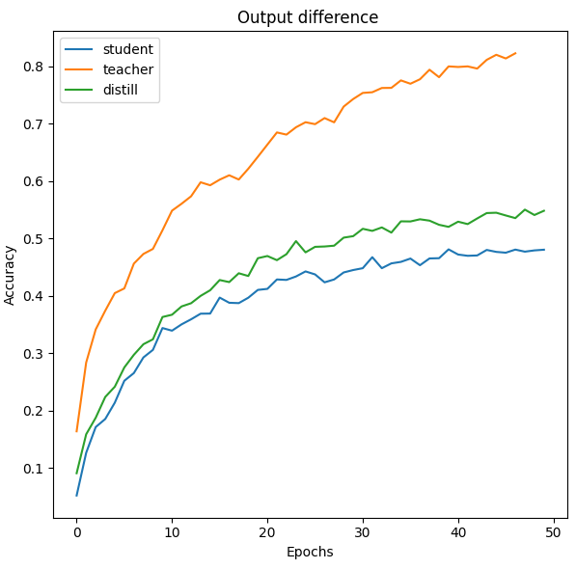
Distillation model:
From the graph we can observe that accuracy curve of the student model with distillation has increased when compared to student model without distillation.

Slide 12
Challenges
Architecture Mismatch
Mismatched architectures (e.g., CNN teacher vs. Transformer student) can hinder effective knowledge transfer.
Knowledge Compression Difficulty
Smaller student models may struggle to capture all the knowledge from the teacher.
Task-Specific Limitations
KD works well for classification tasks but struggles with more complex tasks like sequence generation.

Slide 13
Conclusion
Key Takeaways: Efficient models can retain high accuracy. Enables real-time applications on resource-constrained devices. Future Directions: Extending distillation to multimodal tasks, we can use self attention for better accuracy, self-supervised learning.

Slide 14

Thank you

